Slide 1
Final Project Review
Customer Segmentation
BATCH NUMBER: 02
Presented by:
24B11AI159 - K. Keerthi Reddy - AIML
25B21AI020 - P. Gayathri - AIML
24B11AI154 - K. Rishi Sahithi - AIML
Under esteemed guidance of:
Mr. D. Priyanth
M.Tech, Assistant Professor (AIML)

Slide 2

Outline
1.Problem formulation
2.Problem Definition
3.Literature review
4.Research Gaps
5.Objectives
6.Methodology
7.Technological requirements
8.Expected outcome
9.Conclusion
10.References.

Slide 3
Problem Formulation
In today’s competitive business environment, organizations generate large volumes of customer data from various sources such as transactions, purchase history, and digital interactions. Although this data contains valuable insights into customer behavior and preferences, extracting meaningful information is challenging due to its size, complexity, and diversity. Traditional analysis methods often rely on basic statistical techniques, which are insufficient for identifying distinct customer segments, handling high-dimensional data, and uncovering hidden patterns. As a result, businesses face difficulties in implementing personalized marketing strategies, improving customer satisfaction, and increasing retention. Therefore, there is a need for an intelligent, scalable, and data-driven customer segmentation system that leverages advanced machine learning techniques to accurately group customers and support better decision-making

Slide 4
Problem Definition
Traditional customer analysis methods mainly rely on manual techniques and basic statistical approaches, which are not efficient for handling large and complex datasets. These methods often fail to identify meaningful patterns in customer behavior and are time-consuming.
They are unable to process large-scale customer data generated from multiple sources such as transactions, demographics, and online activities. As a result, businesses cannot effectively identify different customer groups or understand their preferences.
Additionally, these systems lack real-time processing and do not support dynamic segmentation, making it difficult to adapt to changing customer behavior. The results obtained are often less accurate and not suitable for strategic decision-making.
Therefore, there is a need for an automated, scalable, and intelligent customer segmentation system that can analyze large datasets efficiently and provide accurate grouping of customers for better business insights.

Slide 5
Literature Review
Author / Year | Method Used | Description | Limitations
Smith et al. (2020) | K-Means Clustering | Used K-Means algorithm to group customers based on income and spending score for targeted marketing. | Sensitive to initial centroid selection and requires predefined number of clusters
Sharma & Gupta (2021) | Hierarchical Clustering | Applied hierarchical clustering to identify customer segments based on purchasing behavior. | Computationally expensive for large datasets and difficult to scale.
Kumar et al. (2022) | Machine Learning Models | Combined clustering with classification models for better segmentation and prediction. | Requires proper feature selection and high computational resources.
Research Papers (General) | Hybrid Approaches | Integrated multiple algorithms and preprocessing techniques to improve segmentation accuracy. | Complexity increases and implementation becomes difficult

Slide 6
Research Gap
Existing customer segmentation systems mainly rely on basic clustering techniques such as K-Means or Hierarchical Clustering without proper optimization or integration of multiple methods. Many approaches focus only on limited customer attributes like age and income, ignoring important behavioral factors such as purchasing patterns and spending habits.
In addition, data preprocessing and feature selection are often not handled effectively, which leads to inaccurate and inconsistent segmentation results. Most existing systems also struggle to handle large-scale, real-world datasets and lack scalability for dynamic business environments.
Therefore, there is a need for a robust and efficient customer segmentation system that integrates data preprocessing, feature engineering, and advanced clustering algorithms to provide accurate, scalable, and meaningful customer groups for better business decision-making.

Slide 7
Objectives
To develop a machine learning-based customer segmentation system
To perform data preprocessing and cleaning
To identify important features like income, spending score, age
To apply clustering algorithms like K-Means and Hierarchical Clustering
To improve segmentation accuracy and business decision-making Visualize customer segments using graphs for better understanding
Provide insights to improve marketing and customer retention

Slide 8
Challenges and Risks
Handling large and complex customer datasets
Managing missing, noisy, or inconsistent data
Identifying important features affecting customer behavior
Selecting the optimal number of clusters
Risk of overfitting in clustering models
Ensuring data privacy and security
Maintaining consistent segmentation accuracy
Difficulty in interpreting and labeling clusters
High computational cost for large datasets
Challenges in real-time implementation and system integration

Slide 9
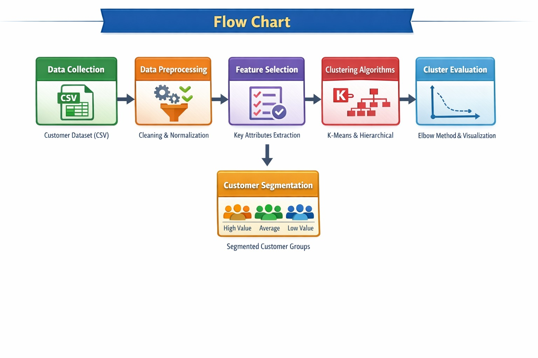
Methodology
Customer data is collected from a customer segmentation dataset (CSV file) containing attributes such as Age, Gender, Annual Income, and Spending Score.
Data preprocessing is performed, including data cleaning, handling missing values, normalization, and feature selection to ensure data quality and consistency.
The dataset is then divided into relevant feature sets for analysis, focusing on key attributes that influence customer behavior.
Machine learning algorithms such as K-Means Clustering and Hierarchical Clustering are applied to group customers into distinct segments based on similarities in their data.
Model performance is evaluated using visualization techniques such as cluster plots and graphs.

Slide 10
Technology Requirements
Software Requirements:
Programming Language: Python
Machine Learning: Scikit-learn
Backend: Flask / Django
Database: MySQL / Firebase
Frontend: HTML, CSS, JavaScript
Hardware Requirements:
Processor: Intel i5 or above
RAM: Minimum 8GB
Storage: 256GB SSD

Slide 11
Dataset Requirements
Customer Segmentation Dataset (Kaggle)
Features include:
Customer ID
Age
Gender
Annual Income
Spending Score

Slide 12
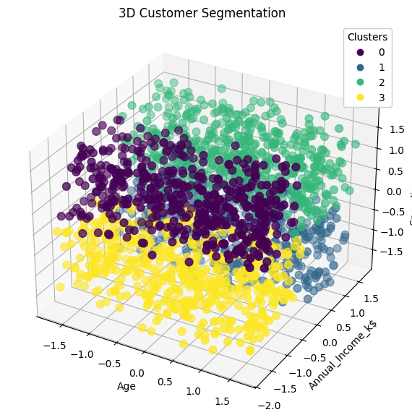
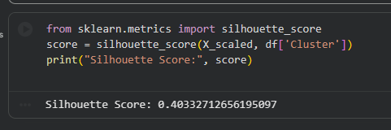
Final Result

Slide 13
Conclusion
The system successfully segments customers using machine learning techniques.
It helps businesses:
Improve marketing strategies
Increase customer satisfaction
Boost sales and revenue
Future Enhancements:
Real-time segmentation
Integration with CRM systems
Personalized recommendation systems

Slide 14
References
T. Hastie, R. Tibshirani , and J. Friedman, “The Elements of Statistical Learning”, Springer, 2009.
2. J. Han, M. Kamber, and J. Pei, “Data Mining: Concepts and Techniques”, Morgan Kaufmann, 2011.
3. Scikit-learn Developers, “Scikit-learn: Machine Learning in Python”, 2025. [Online]. Available: https://scikit-learn.org
4. Google Colaboratory , “Google Colab Documentation”, [Online]. Available: https://colab.research.google.com
5. J. VanderPlas, “Python Data Science Handbook: Essential Tools for Working with Data”, O’Reilly Media, 2016.

Slide 15
THANK YOU

